Slide 1

William Stallings Computer Organization and Architecture Compiled by: Abdul Haseeb
Notes:
Lecture slides prepared for “Computer Organization and Architecture”, 10/e, by William Stallings, Chapter 1 “Introduction”.

Slide 2
Introduction to Course
Power point slides are for me, you read the book
Assessment (Theory 100 Marks)
30% mid exam
10% Assignments/Class tasks
5% Class Quizzes
5% Presentations
50% Final Exam
Course Outline

Slide 3
Chapter 1
Basic Concepts and Computer Evolution
Notes:
In a class of computers called microcomputers, the relationship between architecture
and organization is very close. Changes in technology not only influence
organization but also result in the introduction of more powerful and more complex
architectures. Generally, there is less of a requirement for generation-
To-generation compatibility for these smaller machines. Thus, there is more interplay between
organizational and architectural design decisions. An intriguing example of this is
the reduced instruction set computer (RISC), which we examine in Chapter 15.
This book examines both computer organization and computer architecture.
The emphasis is perhaps more on the side of organization. However, because a
computer organization must be designed to implement a particular architectural
specification, a thorough treatment of organization requires a detailed examination
of architecture as well.

Slide 4
Computer?
An electronic machine, which:
Takes Input
Processes it
Produces output

Slide 5
Different Types of Computers?
Super Computer
Mainframe Computer
Server Computer
Mini Computer
Micro Computer

Slide 6
Buzz words!
Architecture
Organization
Instruction set
Structure
Function

Slide 7
Computer Architecture
Architecture is those attributes visible to the programmer
Instruction set,
number of bits used for data representation,
I/O mechanisms,
addressing techniques.
Architecture describe what the computer does?
e.g. Is there a multiply instruction?

Slide 8
Computer Organization
Organization is how features are implemented
Realization of a hardware
Hardware details – Such as RAM, Hard drive , graphic card technology used.
Peripherals Devices – How devices such as mouse and keyboard, connected to the computer.
Control signals. Generating from above mentioned controls
e.g. Is there a hardware multiply unit or is it done by repeated addition?

Slide 9
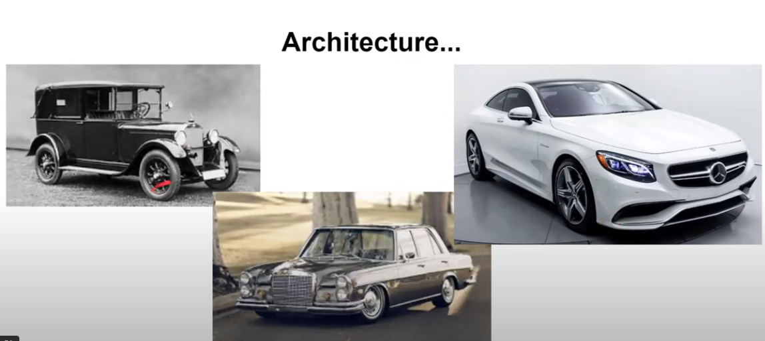

Slide 10
Concept of computer ‘Family’
A computer family is a category of computers with similar designs and microprocessors that are compatible.
Good examples of different computer families are the IBM or PC family versus the Apple or Mac family of computers
Mostly, all computer families have successive generations, they do share the same architecture. But there are always exceptions

Slide 11
Structure & Function
Computer is a complex system with millions of elementary electronic components
How can one describe them? Key is to recognize the hierarchical nature of the system
Hierarchical system: a set of interrelated subsystems
At each level of hierarchy designer is concerned with two things:
Structure: the way in which components relate to each other
Function: the operation of individual components as part of the structure
The author takes a top down approach to explain the system

Slide 12
Function
There are four basic functions that a computer can perform:
Data processing
Data may take a wide variety of forms and the range of processing requirements is broad
Data storage
Short-term
Long-term
Data movement
Input-output (I/O) - when data are received from or delivered to a device (peripheral) that is directly connected to the computer
Data communications – when data are moved over longer distances, to or from a remote device
Control
A control unit manages the computer’s resources and orchestrates the performance of its functional parts in response to instructions
Notes:
Both the structure and functioning of a computer are, in essence, simple. Figure 1.1
depicts the basic functions that a computer can perform. In general terms, there are
only four:
Data Processing. The data may take a wide
variety of forms, and the range of processing requirements is broad. However, we
shall see that there are only a few fundamental methods or types of data processing.
Data Storage. Even if the computer is processing
data on the fly (i.e., data come in and get processed, and the results go out
immediately), the computer must temporarily store at least those pieces of data
that are being worked on at any given moment. Thus, there is at least a short-term
data storage function. Equally important, the computer performs a long-term data
storage function. Files of data are stored on the computer for subsequent retrieval
and update.
Data Movement. The computer’s operating environment consists of devices that serve as
either sources or destinations of data. When data are received from or delivered to
a device that is directly connected to the computer, the process is known as input–
output (I/O), and the device is referred to as a peripheral. When data are moved
over longer distances, to or from a remote device, the process is known as data
communications.
Control. Within the computer, a control unit manages the computer’s resources and orchestrates the
performance of its functional parts in response to those instructions.

Slide 13
Structure
Notes:
We now look in a general way at the internal structure of a computer. We begin with
a traditional computer with a single processor that employs a microprogrammed
control unit, then examine a typical multicore structure.
Figure 1.1 provides a hierarchical view
of the internal structure of a traditional single-processor computer.

Slide 14
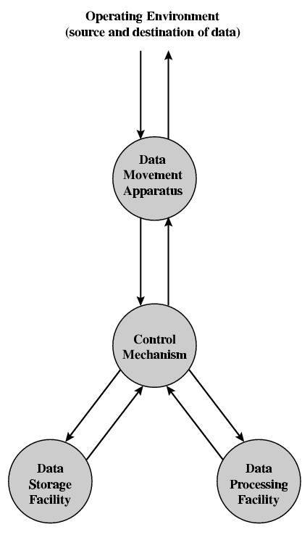
Functional View

Slide 15
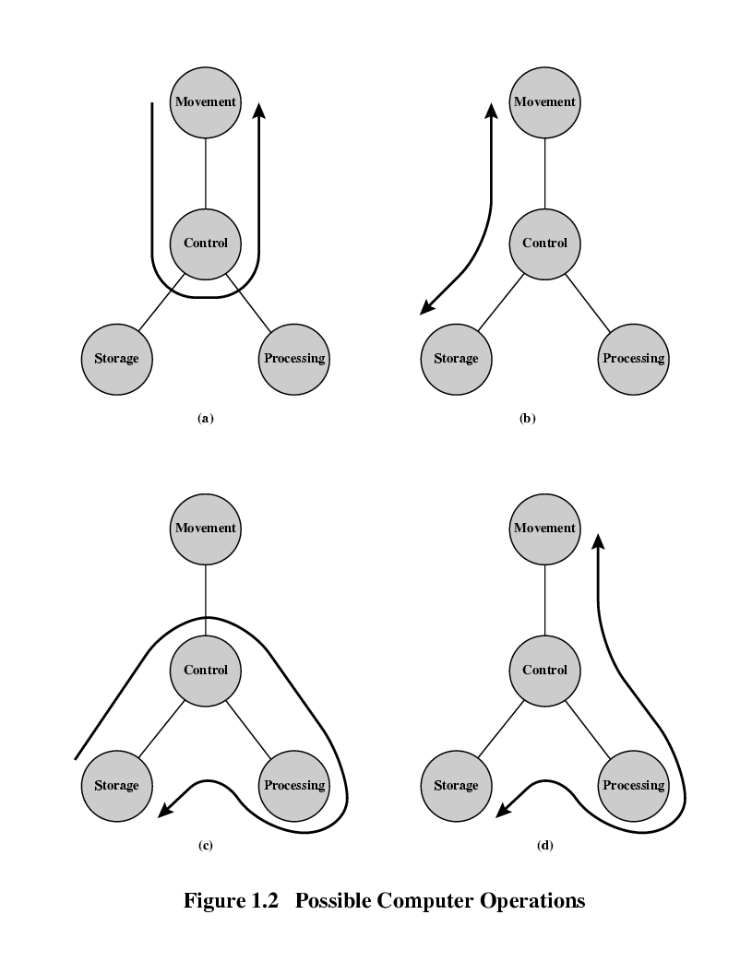
Data movement

Slide 16
Storage

Slide 17
Processing
(From or To Storage)

Slide 18
Processing
(From or To I/O)

Slide 19
Computer
CPU – controls the operation of the computer and performs its data processing functions
Main Memory – stores data
I/O – moves data between the computer and its external environment
System Interconnection – some mechanism that provides for communication among CPU, main memory, and I/O
There are four main structural components
of the computer:
Major structural components:
Notes:
There are four main structural components:
• Central processing unit (CPU): Controls the operation of the computer and
performs its data processing functions; often simply referred to as processor.
• Main memory: Stores data.
• I/O: Moves data between the computer and its external environment.
• System interconnection: Some mechanism that provides for communication
among CPU, main memory, and I/O. A common example of system interconnection
is by means of a system bus, consisting of a number of conducting
wires to which all the other components attach.

Slide 20
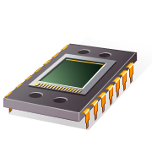
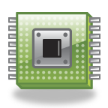
CPU
Control Unit
Controls the operation of the CPU and hence the computer
Arithmetic and Logic Unit (ALU)
Performs the computer’s data processing function
Registers
Provide storage internal to the CPU
CPU Interconnection
Some mechanism that provides for communication among the control unit, ALU, and registers
Major structural components:
Notes:
There may be one or more of each of the aforementioned components.
Traditionally, there has been just a single processor. In recent years, there has been
increasing use of multiple processors in a single computer. Some design issues relating
to multiple processors crop up and are discussed as the text proceeds; Part Five
focuses on such computers.
Each of these components will be examined in some detail in Part Two.
However, for our purposes, the most interesting and in some ways the most complex
component is the CPU. Its major structural components are as follows:
• Control unit: Controls the operation of the CPU and hence the computer.
• Arithmetic and logic unit (ALU): Performs the computer’s data processing
functions.
• Registers: Provides storage internal to the CPU.
• CPU interconnection: Some mechanism that provides for communication
among the control unit, ALU, and registers.
Part Three covers these components, where we will see that complexity is added by
the use of parallel and pipelined organizational techniques. Finally, there are several
approaches to the implementation of the control unit; one common approach is
a microprogrammed implementation. In essence, a microprogrammed control unit
operates by executing microinstructions that define the functionality of the control
unit. With this approach, the structure of the control unit can be depicted, as in
Figure 1.1. This structure is examined in Part Four.

Slide 21
Why CA?
No Computers mean:
Most of the concepts remain mathematical and theoretical
Day to Day Advancements in the field of CS:
RAM speed
Processor Speed
SSD/HDD
Design a balanced system
As a computer Scientist one must know:
How components interact
How data is moved
How to troubleshoot issues

Slide 22
Review! Write answers on a page and submit
What is in general terms distinction between Computer Architecture and Organization
Structure vs function
Names of main structural components of a processor

Slide 23
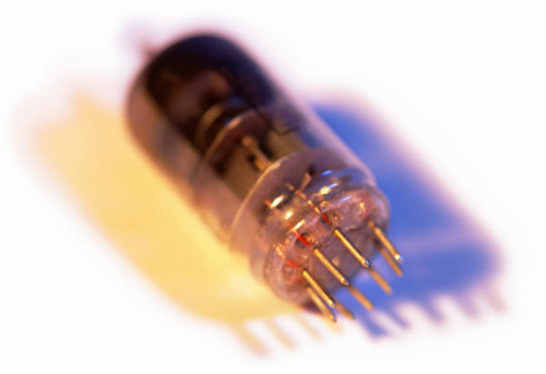
History of Computers
First Generation: Vacuum Tubes
Vacuum tubes were used for digital logic elements and memory
IAS computer
Fundamental design approach was the stored program concept
Attributed to the mathematician John von Neumann
First publication of the idea was in 1945 for the EDVAC( Electronic discrete Variable Computer
Design began at the Princeton Institute for Advanced Studies in 1946
Completed in 1952
Prototype of all subsequent general-purpose computers
Notes:
The first generation of computers used vacuum tubes for digital logic elements and
memory. A number of research and then commercial computers were built using
vacuum tubes. For our purposes, it will be instructive to examine perhaps the most
famous first-generation computer, known as the IAS computer.
A fundamental design approach first implemented in the IAS computer is
known as the stored-program concept . This idea is usually attributed to the mathematician
John von Neumann. Alan Turing developed the idea at about the same time.
The first publication of the idea was in a 1945 proposal by von Neumann for a new
computer, the EDVAC (Electronic Discrete Variable Computer).3
In 1946, von Neumann and his colleagues began the design of a new stored-
program computer, referred to as the IAS computer, at the Princeton Institute for
Advanced Studies. The IAS computer, although not completed until 1952, is the
prototype of all subsequent general-purpose computers.

Slide 24
Notes:
Figure 1.6 shows the general structure of the IAS computer (compare with Figure 1.1).
It consists of
• A main memory, which stores both data and instructions
• An arithmetic and logic unit (ALU) capable of operating on binary data
• A control unit, which interprets the instructions in memory and causes them
to be executed
• Input/output (I/O) equipment operated by the control unit
This structure was outlined in von Neumann’s earlier proposal, which is worth
quoting in part at this point [VONN45]:
2.2 First: Since the device is primarily a computer, it will
have to perform the elementary operations of arithmetic most frequently.
These are addition, subtraction, multiplication, and division.
It is therefore reasonable that it should contain specialized
organs for just these operations.
It must be observed, however, that while this principle as such
is probably sound, the specific way in which it is realized requires
close scrutiny. At any rate a central arithmetical part of the device will
probably have to exist, and this constitutes the first specific part: CA .
2.3 Second: The logical control of the device, that is, the
proper sequencing of its operations, can be most efficiently carried
out by a central control organ. If the device is to be elastic ,
that is, as nearly as possible all purpose , then a distinction must
be made between the specific instructions given for and defining
a particular problem, and the general control organs that see to it
that these instructions—no matter what they are—are
carried out. The former must be stored in some way; the latter are represented
by definite operating parts of the device. By the central control we
mean this latter function only, and the organs that perform it form
the second specific part: CC .
2.4 Third: Any device that is to carry out long and complicated
sequences of operations (specifically of calculations) must
have a considerable memory . . .
The instructions which govern a complicated problem may
constitute considerable material, particularly so, if the code is circumstantial
(which it is in most arrangements). This material must
be remembered.
At any rate, the total memory constitutes the third specific
part of the device: M.
2.6 The three specific parts CA, CC (together C), and M correspond
to the associative neurons in the human nervous system. It
remains to discuss the equivalents of the sensory or afferent and the
motor or efferent neurons. These are the input and output organs of
the device. The device must be endowed with the ability to maintain
input and output (sensory and motor) contact with some specific
medium of this type. The medium will be called the outside recording
medium of the device: R .
2.7 Fourth: The device must have organs to transfer information
from R into its specific parts C and M. These organs form its
input , the fourth specific part: I . It will be seen that it is best to make
all transfers from R (by I) into M and never directly from C.
2.8 Fifth: The device must have organs to transfer from its
specific parts C and M into R. These organs form its output , the
fifth specific part: O . It will be seen that it is again best to make all
transfers from M (by O) into R, and never directly from C.

Slide 25
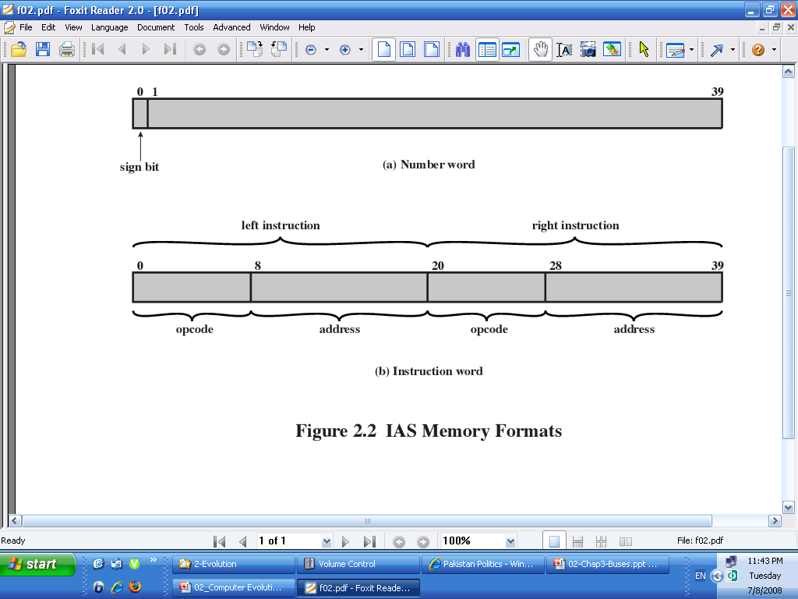
IAS
Consist of 1000 storage locations-Words
1 Word—40 bits
Numbers and instructions are represented in binary form
Number→ 1 Sign bit + 39 bit value
Instruction→ 20 bit (8 bit for opcode+ 12 bit for address)

Slide 26
Registers
Memory buffer register (MBR)
Contains a word to be stored in memory or sent to the I/O unit
Or is used to receive a word from memory or from the I/O unit
Memory address register (MAR)
Specifies the address in memory of the word to be written from or read into the MBR
Instruction register (IR)
Contains the 8-bit opcode instruction being executed
Instruction buffer register (IBR)
Employed to temporarily hold the right-hand instruction from a word in memory
Program counter (PC)
Contains the address of the next instruction pair to be fetched from memory
Accumulator (AC) and multiplier quotient (MQ)
Employed to temporarily hold operands and results of ALU operations
Notes:
The control unit operates the IAS by fetching instructions from memory
and executing them one at a time. We explain these operations with reference to
Figure 1.6. This figure reveals that both the control unit and the ALU contain storage
locations, called registers , defined as follows:
Memory buffer register (MBR): Contains a word to be stored in memory or sent
to the I/O unit, or is used to receive a word from memory or from the I/O unit.
• Memory address register (MAR): Specifies the address in memory of the word
to be written from or read into the MBR.
• Instruction register (IR ): Contains the 8-bit opcode instruction being executed.
• Instruction buffer register (IBR): Employed to hold temporarily the right-hand
instruction from a word in memory.
• Program counter (PC): Contains the address of the next instruction pair to be
fetched from memory.
• Accumulator (AC) and multiplier quotient (MQ): Employed to hold temporarily
operands and results of ALU operations. For example, the result of
multiplying two 40-bit numbers is an 80-bit number; the most significant 40 bits
are stored in the AC and the least significant in the MQ.

Slide 27
Table 1.1
The IAS
Instruction Set
(Table can be found on page 17 in the textbook.)
Notes:
The IAS computer had a total of 21 instructions, which are listed in Table 1.1.
These can be grouped as follows:
• Data transfer: Move data between memory and ALU registers or between
two ALU registers.
Unconditional branch: Normally, the control unit executes instructions in
sequence from memory. This sequence can be changed by a branch instruction,
which facilitates repetitive operations.
• Conditional branch: The branch can be made dependent on a condition, thus
allowing decision points.
• Arithmetic: Operations performed by the ALU.
• Address modify: Permits addresses to be computed in the ALU and then
inserted into instructions stored in memory. This allows a program considerable
addressing flexibility.
Table 1.1 presents instructions in a symbolic, easy-to-read form. Actually,
each instruction must conform to the format of Figure 1.7b. The opcode portion
(first 8 bits) specifies which of the 21 instructions is to be executed. The address
portion (remaining 12 bits) specifies which of the 4,096 memory locations is to be
involved in the execution of the instruction.

Slide 28
Notes:
The IAS operates by repetitively performing an instruction cycle, as shown in
Figure 1.8. Each instruction cycle consists of two sub-cycles. During the fetch cycle,
the opcode of the next instruction is loaded into the IR and the address portion is
loaded into the MAR. This instruction may be taken from the IBR, or it can be
obtained from memory by loading a word into the MBR, and then down to the IBR,
IR, and MAR.
Why the indirection? These operations are controlled by electronic circuitry
and result in the use of data paths. To simplify the electronics, there is only one
register that is used to specify the address in memory for a read or write and only
one register used for the source or destination.
Once the opcode is in the IR, the execute cycle is performed. Control circuitry
interprets the opcode and executes the instruction by sending out the appropriate
control signals to cause data to be moved or an operation to be performed by the
ALU.

Slide 29
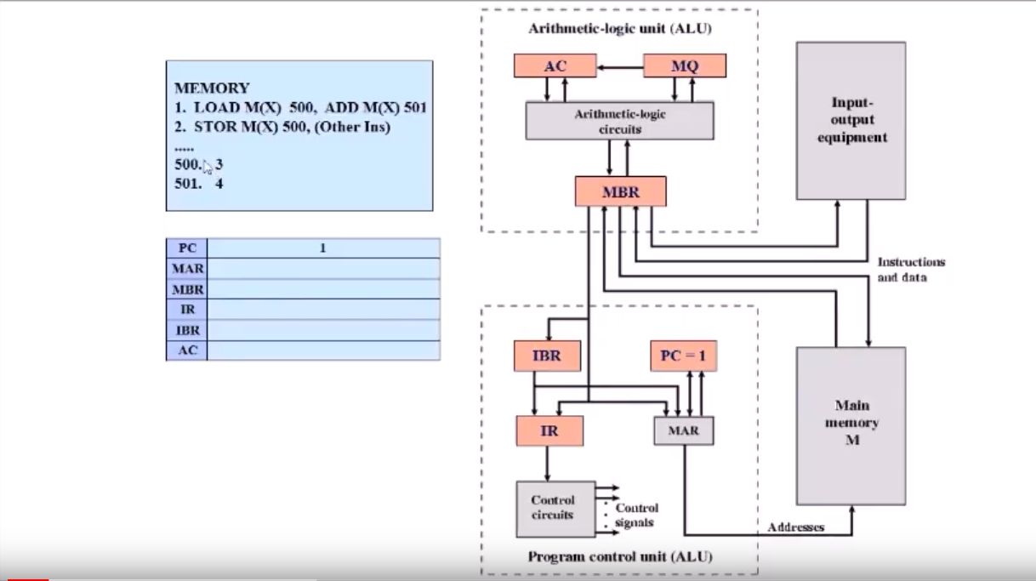
Example

Slide 30
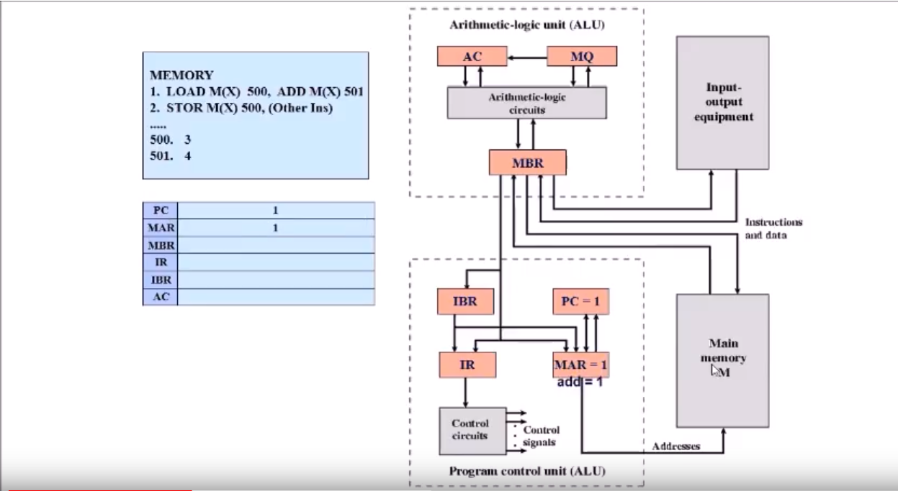
PC==1 (Copy this address to MAR )

Slide 31
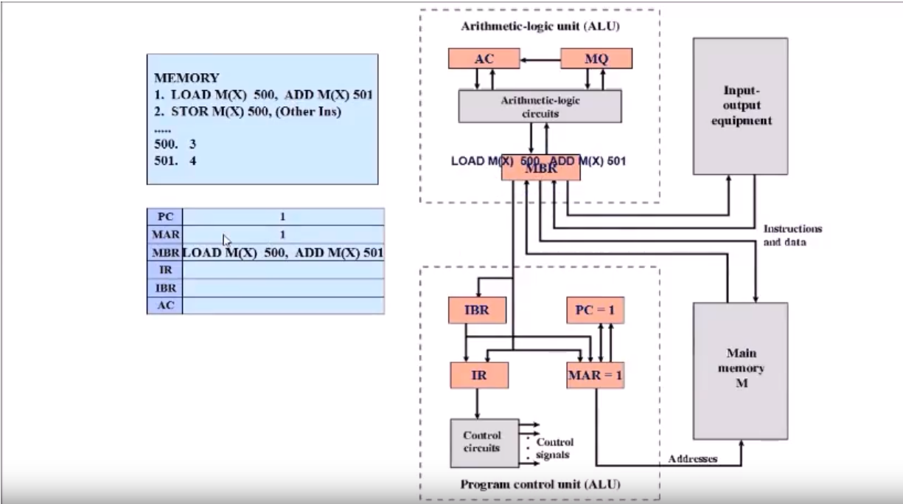
Go to Memory address 1 and place instruction in MBR

Slide 32
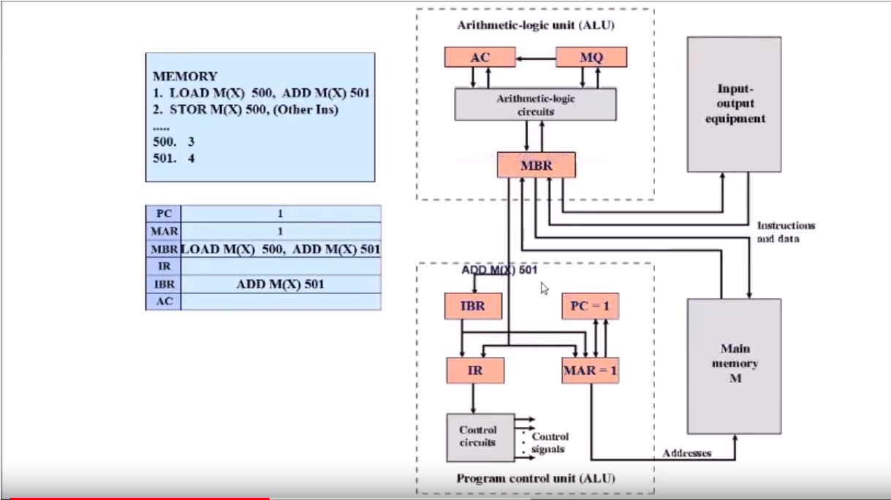
Execute Left Instruction, copy right instruction in IBR

Slide 33
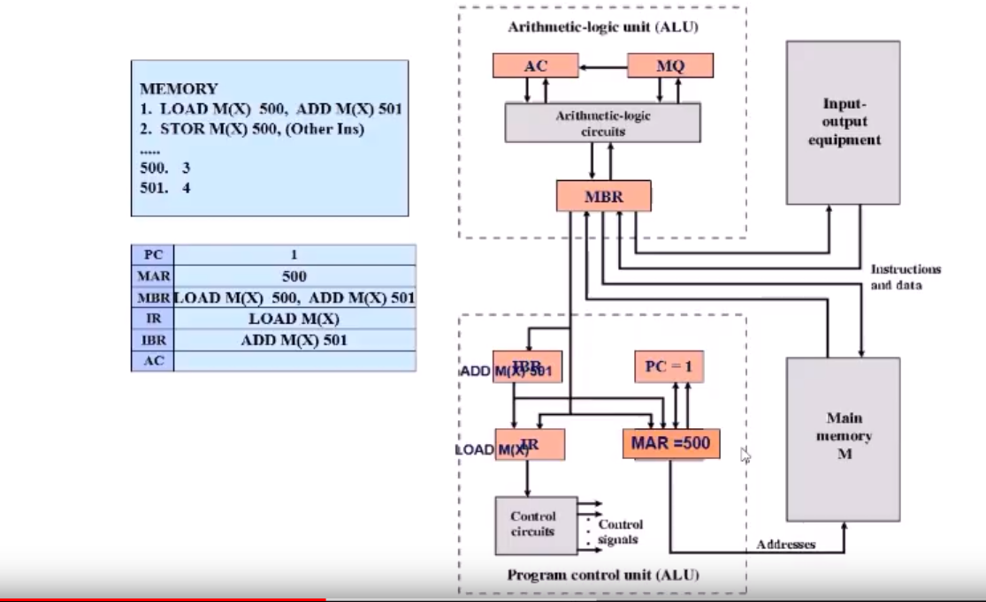
Put the left instruction opcode in IR and operand address in MAR

Slide 34
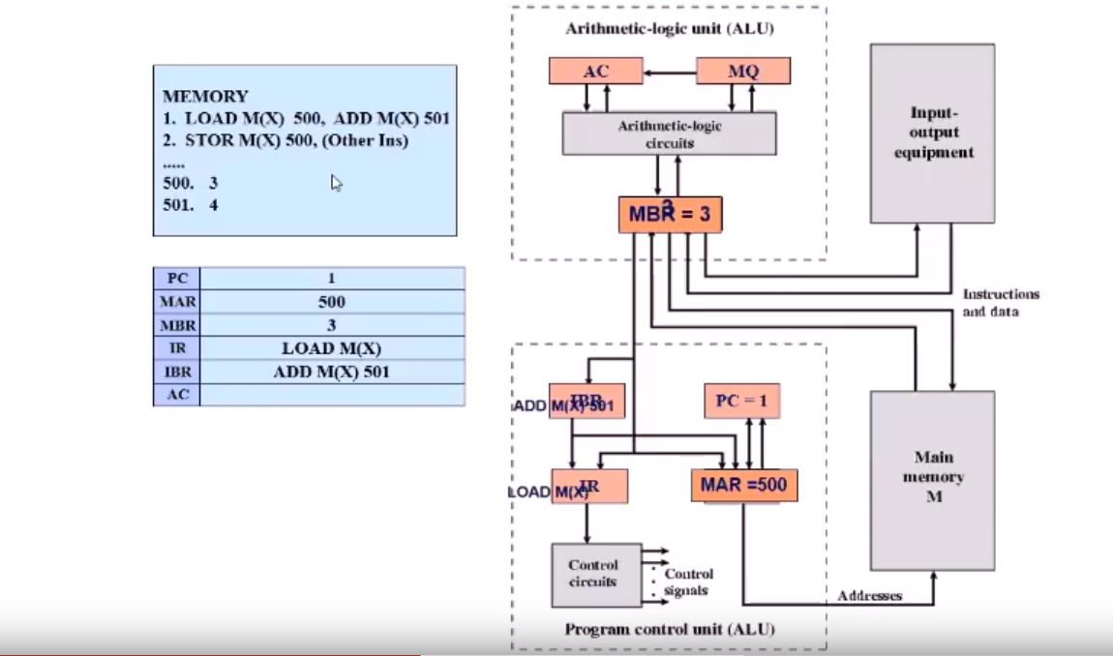
Get the operand value from memory and place it in MBR

Slide 35
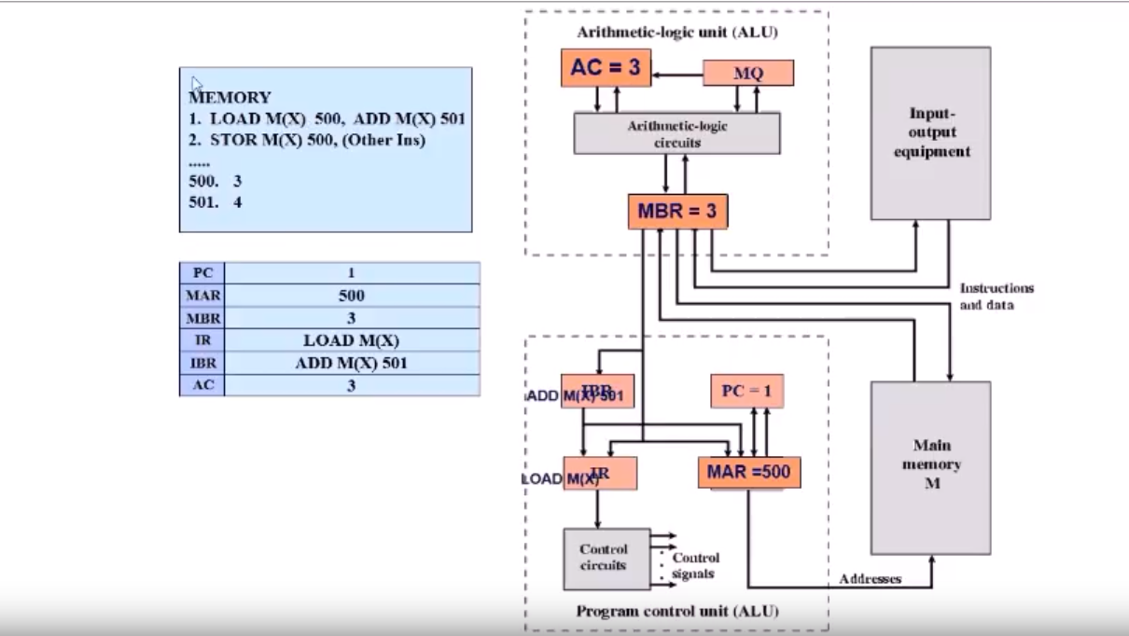
MBR value copied to accumulator-completed left instruction execution

Slide 36
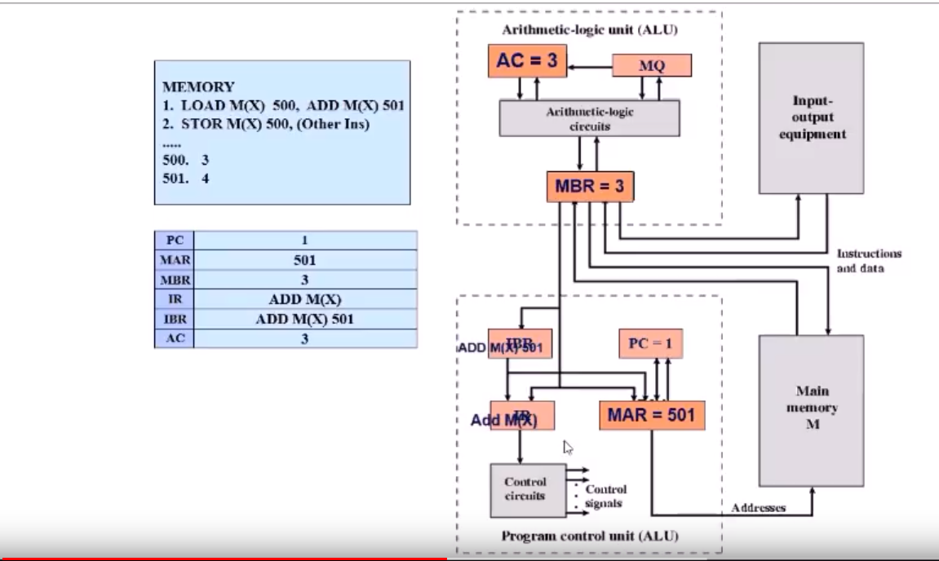
Right Instruction- opcode in IR & address in MAR

Slide 37
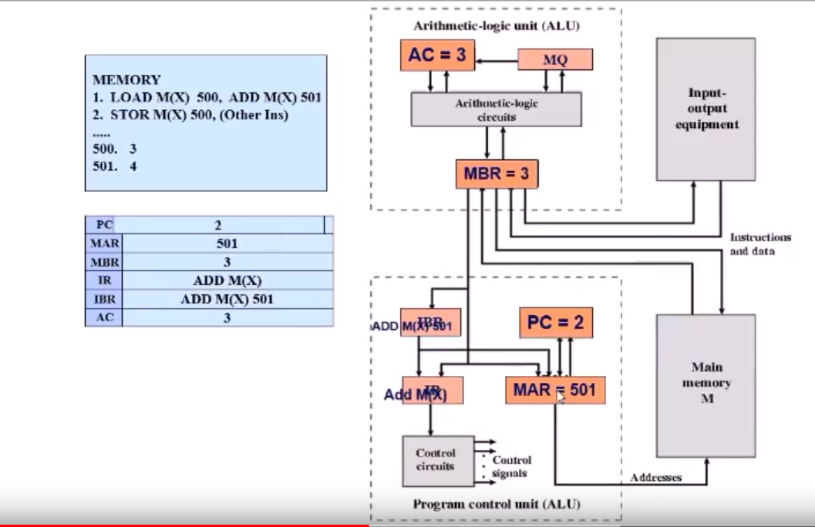
PC is incremented by 1-→ 2

Slide 38
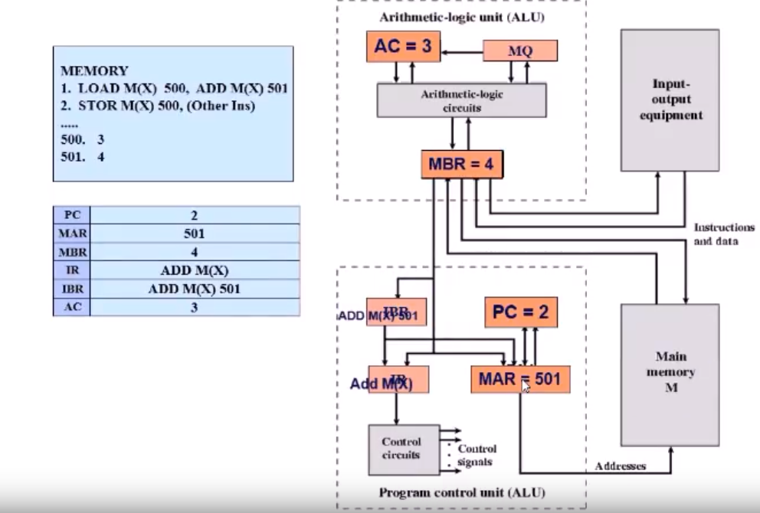
MAR value is passed to memory and contents are again stored in MBR

Slide 39

Now, MBR value is added with accumulator value

Slide 40
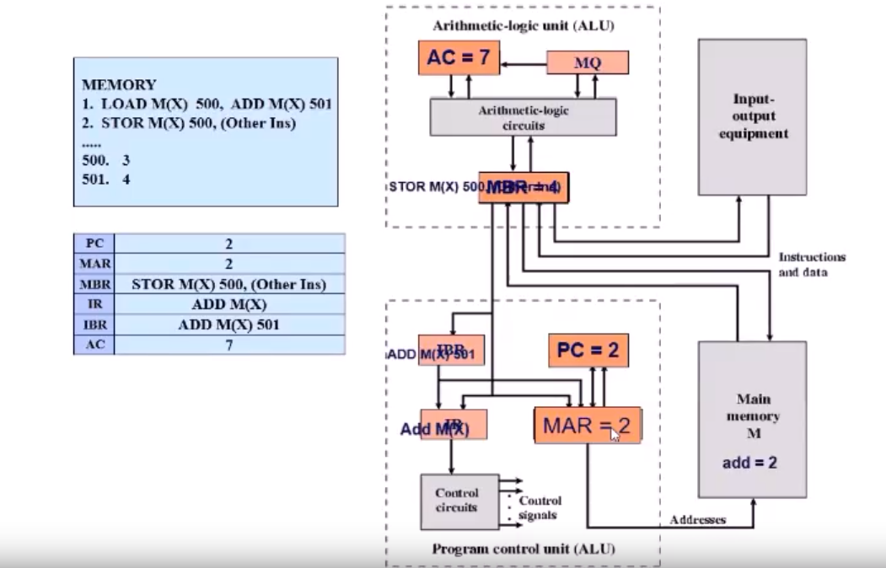
Now—PC is checked again and value is transferred to MAR, From memory contents are pasted in MBR

Slide 41
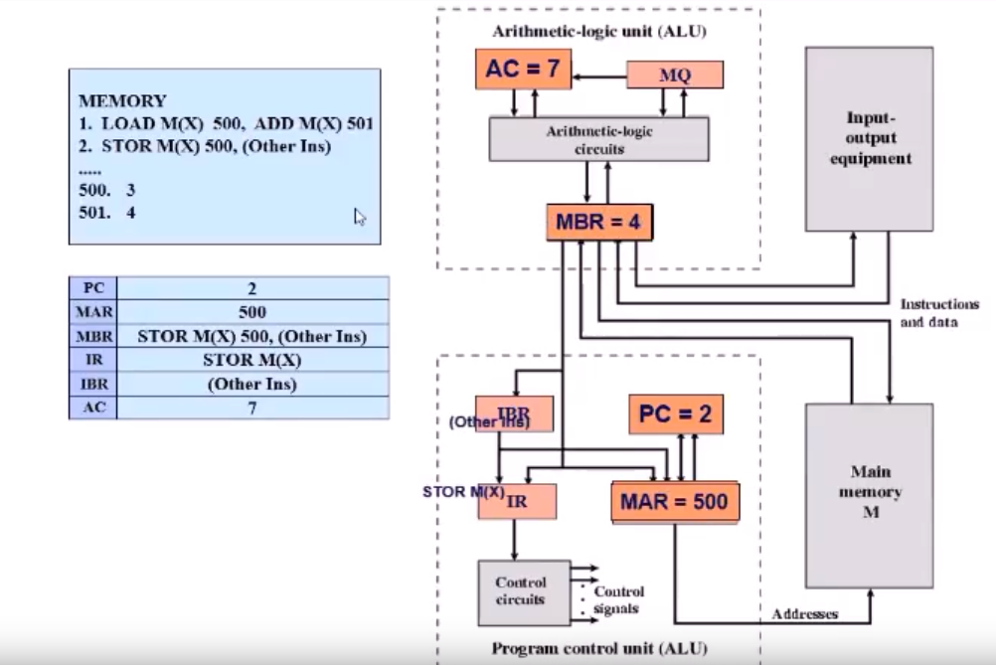
What is happening??

Slide 42
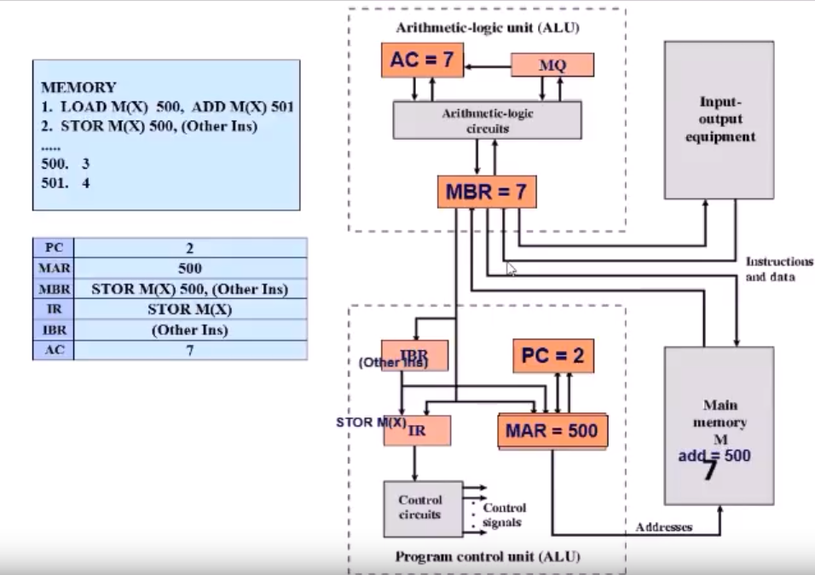
Left Instruction executed: Transfer Ac value to Memory location M(X)

Slide 43
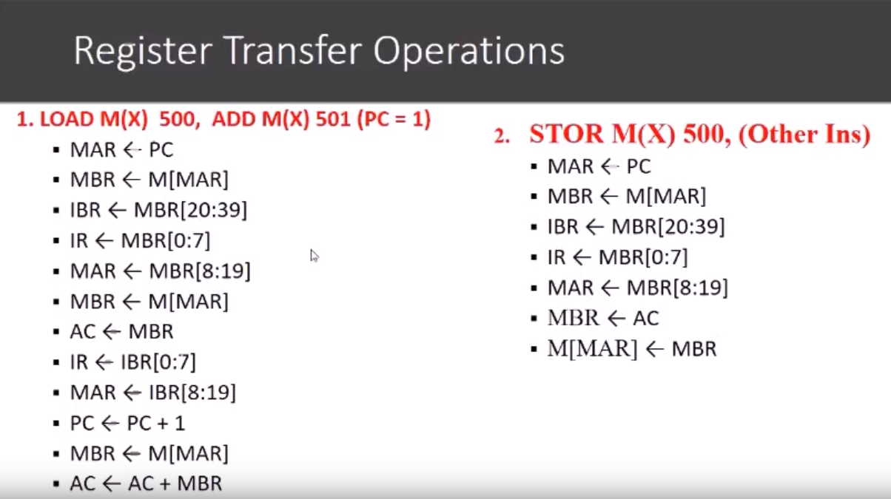

Slide 44
Do it Yourself ☺
1. Load M(x), 400, Sub M(x), 401
2. Add M(x),402
….
400= 6
401=2
402=3

Slide 45
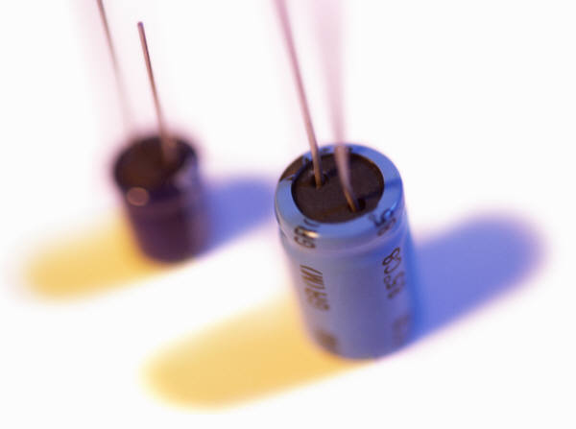
History of Computers
Second Generation: Transistors
Smaller
Cheaper
Dissipates less heat than a vacuum tube
Is a solid state device made from silicon
Was invented at Bell Labs in 1947
It was not until the late 1950’s that fully transistorized computers were commercially available
Notes:
The first major change in the electronic computer came with the replacement of
the vacuum tube by the transistor. The transistor is smaller, cheaper, and dissipates
less heat than a vacuum tube but can be used in the same way as a vacuum tube to
construct computers. Unlike the vacuum tube, which requires wires, metal plates, a
glass capsule, and a vacuum, the transistor is a solid-state device, made from silicon.
The transistor was invented at Bell Labs in 1947 and by the 1950s had launched
an electronic revolution. It was not until the late 1950s, however, that fully transistorized
computers were commercially available. The use of the transistor defines
the second generation of computers.

Slide 46
Table 1.2 Computer Generations
Notes:
It has become widely accepted to classify computers into generations based on the fundamental
hardware technology employed (Table 1.2). Each new generation is characterized
by greater processing performance, larger memory capacity, and smaller
size than the previous one.

Slide 47
Second Generation Computers
Introduced:
More complex arithmetic and logic units and control units
The use of high-level programming languages
Provision of system software which provided the ability to:
Load programs
Move data to peripherals
Libraries perform common computations
Notes:
But there are other changes as well. The second generation saw the introduction
of more complex arithmetic and logic units and control units, the use of
high-level programming languages, and the provision of system software with the
computer. In broad terms, system software provided the ability to load programs,
move data to peripherals, and libraries to perform common computations, similar
to what modern operating systems like Windows and Linux do.

Slide 48
Notes:
It will be useful to examine an important member of the second generation: the
IBM 7094 [BELL71]. From the introduction of the 700 series in 1952 to the introduction
of the last member of the 7000 series in 1964, this IBM product line underwent
an evolution that is typical of computer products. Successive members of the product
line showed increased performance, increased capacity, and/or lower cost.
Also, over the lifetime of this series of computers, the relative speed of the
CPU increased by a factor of 50. Speed improvements are achieved by improved
electronics (e.g., a transistor implementation is faster than a vacuum tube implementation)
and more complex circuitry. For example, the IBM 7094 includes an
Instruction Backup Register, used to buffer the next instruction. The control unit
fetches two adjacent words from memory for an instruction fetch. Except for the
occurrence of a branching instruction, which is relatively infrequent (perhaps 10 to
15%), this means that the control unit has to access memory for an instruction on
only half the instruction cycles. This prefetching significantly reduces the average
instruction cycle time.
Figure 1.9 shows a large (many peripherals) configuration for an IBM 7094,
which is representative of second-generation computers. Several differences from
the IAS computer are worth noting. The most important of these is the use of data
channels . A data channel is an independent I/O module with its own processor and
instruction set. In a computer system with such devices, the CPU does not execute
detailed I/O instructions. Such instructions are stored in a main memory to be
executed by a special-purpose processor in the data channel itself. The CPU initiates
an I/O transfer by sending a control signal to the data channel, instructing it to
execute a sequence of instructions in memory. The data channel performs its task
independently of the CPU and signals the CPU when the operation is complete.
This arrangement relieves the CPU of a considerable processing burden.
Another new feature is the multiplexor , which is the central termination
point for data channels, the CPU, and memory. The multiplexor schedules access
to the memory from the CPU and data channels, allowing these devices to act
independently.

Slide 49
IBM-7094
includes an Instruction Backup Register, used to buffer the next instruction.
The control unit fetches two adjacent words from memory for an instruction fetch.
A data channel is an independent I/O module with its own processor and instruction set.
CPU does not execute detailed I/O instructions.
The CPU initiates an I/O transfer by sending a control signal to the data channel, instructing it to execute a sequence of instructions in memory.
The multiplexor schedules access to the memory from the CPU and data channels, allowing these devices to act independently.

Slide 50
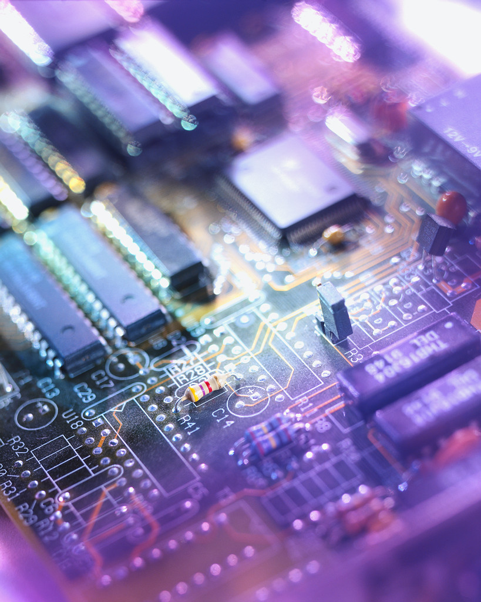
History of Computers
Third Generation: Integrated Circuits
1958 – the invention of the integrated circuit
Discrete component
Single, self-contained transistor
Manufactured separately, packaged in their own containers, and soldered or wired together onto masonite-like circuit boards
Manufacturing process was expensive and cumbersome
The two most important members of the third generation were the IBM System/360 and the DEC PDP-8
Notes:
A single, self-contained transistor is called a discrete component. Throughout the
1950s and early 1960s, electronic equipment was composed largely of discrete components—
transistors, resistors, capacitors, and so on. Discrete components were
manufactured separately, packaged in their own containers, and soldered or wired
together onto masonite-like circuit boards, which were then installed in computers,
oscilloscopes, and other electronic equipment. Whenever an electronic device called
for a transistor, a little tube of metal containing a pinhead-sized piece of silicon
had to be soldered to a circuit board. The entire manufacturing process, from transistor
to circuit board, was expensive and cumbersome.
These facts of life were beginning to create problems in the computer industry.
Early second-generation computers contained about 10,000 transistors. This
figure grew to the hundreds of thousands, making the manufacture of newer, more
powerful machines increasingly difficult.
In 1958 came the achievement that revolutionized electronics and started the
era of microelectronics: the invention of the integrated circuit. It is the integrated
circuit that defines the third generation of computers. In this section, we provide a
brief introduction to the technology of integrated circuits. Then we look at perhaps
the two most important members of the third generation, both of which were introduced
at the beginning of that era: the IBM System/360 and the DEC PDP-8.

Slide 51
Notes:
Microelectronics means, literally, “small electronics.” Since
the beginnings of digital electronics and the computer industry, there has been a
persistent and consistent trend toward the reduction in size of digital electronic
circuits. Before examining the implications and benefits of this trend, we need to
say something about the nature of digital electronics. A more detailed discussion is
found in Chapter 11.
The basic elements of a digital computer, as we know, must perform storage,
movement, processing, and control functions. Only two fundamental types of components
are required (Figure 1.10): gates and memory cells. A gate is a device that
implements a simple Boolean or logical function, such as IF A AND B ARE TRUE
THEN C IS TRUE (AND gate). Such devices are called gates because they control
data flow in much the same way that canal gates control the flow of water. The
memory cell is a device that can store one bit of data; that is, the device can be in
one of two stable states at any time. By interconnecting large numbers of these
fundamental devices, we can construct a computer.

Slide 52
Integrated Circuits
A computer consists of gates, memory cells, and interconnections among these elements
The gates and memory cells are constructed of simple digital electronic components
Data storage – provided by memory cells
Data processing – provided by gates
Data movement – the paths among components are used to move data from memory to memory and from memory through gates to memory
Control – the paths among components can carry control signals
Exploits the fact that such components as transistors, resistors, and conductors can be fabricated from a semiconductor such as silicon
Many transistors can be produced at the same time on a single wafer of silicon
Notes:
We can relate this to our four
basic functions as follows:
• Data storage: Provided by memory cells.
• Data processing: Provided by gates.
• Data movement: The paths among components are used to move data from
memory to memory and from memory through gates to memory.
• Control: The paths among components can carry control signals. For example,
a gate will have one or two data inputs plus a control signal input that activates
the gate. When the control signal is ON, the gate performs its function on the
data inputs and produces a data output. Similarly, the memory cell will store
the bit that is on its input lead when the WRITE control signal is ON and will
place the bit that is in the cell on its output lead when the READ control signal
is ON.
Thus, a computer consists of gates, memory cells, and interconnections among these
elements. The gates and memory cells are, in turn, constructed of simple digital
electronic components.
The integrated circuit exploits the fact that such components as transistors,
resistors, and conductors can be fabricated from a semiconductor such as silicon.
It is merely an extension of the solid-state art to fabricate an entire circuit in a tiny
piece of silicon rather than assemble discrete components made from separate
pieces of silicon into the same circuit. Many transistors can be produced at the same
time on a single wafer of silicon. Equally important, these transistors can be connected
with a process of metallization to form circuits.

Slide 53
Notes:
Figure 1.11 depicts the key concepts in an integrated circuit. A thin wafer of
silicon is divided into a matrix of small areas, each a few millimeters square. The
identical circuit pattern is fabricated in each area, and the wafer is broken up into
chips. Each chip consists of many gates and/or memory cells plus a number of input
and output attachment points. This chip is then packaged in housing that protects
it and provides pins for attachment to devices beyond the chip. A number of these
packages can then be interconnected on a printed circuit board to produce larger
and more complex circuits.

Slide 54
Notes:
Initially, only a few gates or memory cells could be reliably manufactured
and packaged together. These early integrated circuits are referred to as small scale
Integration (SSI). As time went on, it became possible to pack more and more
Components on the same chip. This growth in density is illustrated in Figure 1.12; it is
one of the most remarkable technological trends ever recorded.
This figure reflects the
famous Moore’s law, which was propounded by Gordon Moore, cofounder of Intel,
in 1965 [MOOR65]. Moore observed that the number of transistors that could be
put on a single chip was doubling every year and correctly predicted that this pace
would continue into the near future. To the surprise of many, including Moore, the
pace continued year after year and decade after decade. The pace slowed to a doubling
every 18 months in the 1970s but has sustained that rate ever since.

Slide 55
Moore’s Law
1965; Gordon Moore – co-founder of Intel
Observed number of transistors that could be put on a single chip was doubling every year
The pace slowed to a doubling every 18 months in the 1970’s but has sustained that rate ever since
Consequences of Moore’s law:
The cost of computer logic and memory circuitry has fallen at a dramatic rate
The electrical path length is shortened, increasing operating speed
Computer becomes smaller and is more convenient to use in a variety of environments
Reduction in power and cooling requirements
Fewer interchip connections
Notes:
The consequences of Moore’s law are profound:
1. The cost of a chip has remained virtually unchanged during this period of
rapid growth in density. This means that the cost of computer logic and memory
circuitry has fallen at a dramatic rate.
2. Because logic and memory elements are placed closer together on more
densely packed chips, the electrical path length is shortened, increasing
operating speed.
3. The computer becomes smaller, making it more convenient to place in a
variety of environments.
4. There is a reduction in power and cooling requirements.
5. The interconnections on the integrated circuit are much more reliable than
solder connections. With more circuitry on each chip, there are fewer interchip
connections.

Slide 56
IBM System/360
Announced in 1964
Product line was incompatible with older IBM machines
Was the success of the decade and cemented IBM as the overwhelmingly dominant computer vendor
The architecture remains to this day the architecture of IBM’s mainframe computers
Was the industry’s first planned family of computers
Models were compatible in the sense that a program written for one model should be capable of being executed by another model in the series
Notes:
By 1964, IBM had a firm grip on the computer market with
its 7000 series of machines. In that year, IBM announced the System/360, a new
family of computer products. Although the announcement itself was no surprise, it
contained some unpleasant news for current IBM customers: the 360 product line
was incompatible with older IBM machines. Thus, the transition to the 360 would be
difficult for the current customer base. This was a bold step by IBM, but one IBM felt
was necessary to break out of some of the constraints of the 7000 architecture and
to produce a system capable of evolving with the new integrated circuit technology
[PADE81, GIFF87]. The strategy paid off both financially and technically. The 360
was the success of the decade and cemented IBM as the overwhelmingly dominant
computer vendor, with a market share above 70%. And, with some modifications
and extensions, the architecture of the 360 remains to this day the architecture
of IBM’s mainframe computers. Examples using this architecture can be found
throughout this text.
The System/360 was the industry’s first planned family of computers. The
family covered a wide range of performance and cost. The models were compatible in the sense that
a program written for one model should be capable of being executed by another
model in the series, with only a difference in the time it takes to execute.

Slide 57
Family Characteristics
Similar or identical instruction set
Similar or identical operating system
Increasing speed
Increasing number of I/O ports
Increasing memory size
Increasing cost
Notes:
The concept of a family of compatible computers was both novel and
extremely successful. A customer with modest requirements and a budget to match
could start with the relatively inexpensive Model 30. Later, if the customer’s needs
grew, it was possible to upgrade to a faster machine with more memory without
sacrificing the investment in already-developed software. The characteristics of a
family are as follows:
• Similar or identical instruction set: In many cases, the exact same set of machine
instructions is supported on all members of the family. Thus, a program that
executes on one machine will also execute on any other. In some cases, the
lower end of the family has an instruction set that is a subset of that of the top
end of the family. This means that programs can move up but not down.
• Similar or identical operating system: The same basic operating system is
available for all family members. In some cases, additional features are added
to the higher-end members.
• Increasing speed: The rate of instruction execution increases in going from
lower to higher family members.
• Increasing number of I /O ports: The number of I/O ports increases in going
from lower to higher family members.
• Increasing memory size: The size of main memory increases in going from
lower to higher family members.
• Increasing cost: At a given point in time, the cost of a system increases in going
from lower to higher family members.
How could such a family concept be implemented? Differences were achieved
based on three factors: basic speed, size, and degree of simultaneity [STEV64]. For
example, greater speed in the execution of a given instruction could be gained by
the use of more complex circuitry in the ALU, allowing suboperations to be carried
out in parallel. Another way of increasing speed was to increase the width of the
data path between main memory and the CPU. On the Model 30, only 1 byte (8 bits)
could be fetched from main memory at a time, whereas 8 bytes could be fetched at
a time on the Model 75.
The System/360 not only dictated the future course of IBM but also had a
profound impact on the entire industry. Many of its features have become standard on
other large computers.

Slide 58
DEC-PDP-8
Same year(IBM system/360) –PDP-8 from Digital Equipment Corporation
Small enough to be placed on top of bench
No air-conditioned room required
Cheap enough (Not exact functionality like mainframe)
No central switch architecture (Fig.1.9) IBM
Introduced the concept of Omnibus( Bus structure for microcomputers)

Slide 59
Notes:
In the same year that IBM shipped its first System/360, another
momentous first shipment occurred: PDP-8
from Digital Equipment Corporation(DEC). At a time when the average
computer required an air-conditioned room, the PDP-8
(dubbed a minicomputer by the industry, after the miniskirt of the day)
was small enough that it could be placed on top of a lab bench or be built into
other equipment. It could not do everything the mainframe could, but at $16,000, it
was cheap enough for each lab technician to have one. In contrast, the System/360
series of mainframe computers introduced just a few months before cost hundreds
of thousands of dollars.
The low cost and small size of the PDP-8
enabled another manufacturer to purchase a PDP-8
and integrate it into a total system for resale. These other manufacturers
came to be known as original equipment manufacturers (OEMs) , and the
OEM market became and remains a major segment of the computer marketplace.
In contrast to the central-switched architecture (Figure 1.9) used by IBM on its
700/7000 and 360 systems, later models of the PDP-8
used a structure that became virtually
universal for microcomputers: the bus structure. This is illustrated in Figure 1.13.
The PDP-8 bus, called the Omnibus, consists of 96 separate signal paths, used to carry
control, address, and data signals. Because all system components share a common
set of signal paths, their use can be controlled by the CPU. This architecture is highly
flexible, allowing modules to be plugged into the bus to create various configurations.
It is only in recent years that the bus structure has given way to a structure known as
Point-to-point interconnect, described in Chapter 3.

Slide 60
DEC-PDP-8
Consist of 96 separate signal paths
Used to carry data, address and control signals
All system components share a common set of signal paths
Their use controlled by CPU
Flexible architecture→ modules to be plugged into the bus

